Slide 1
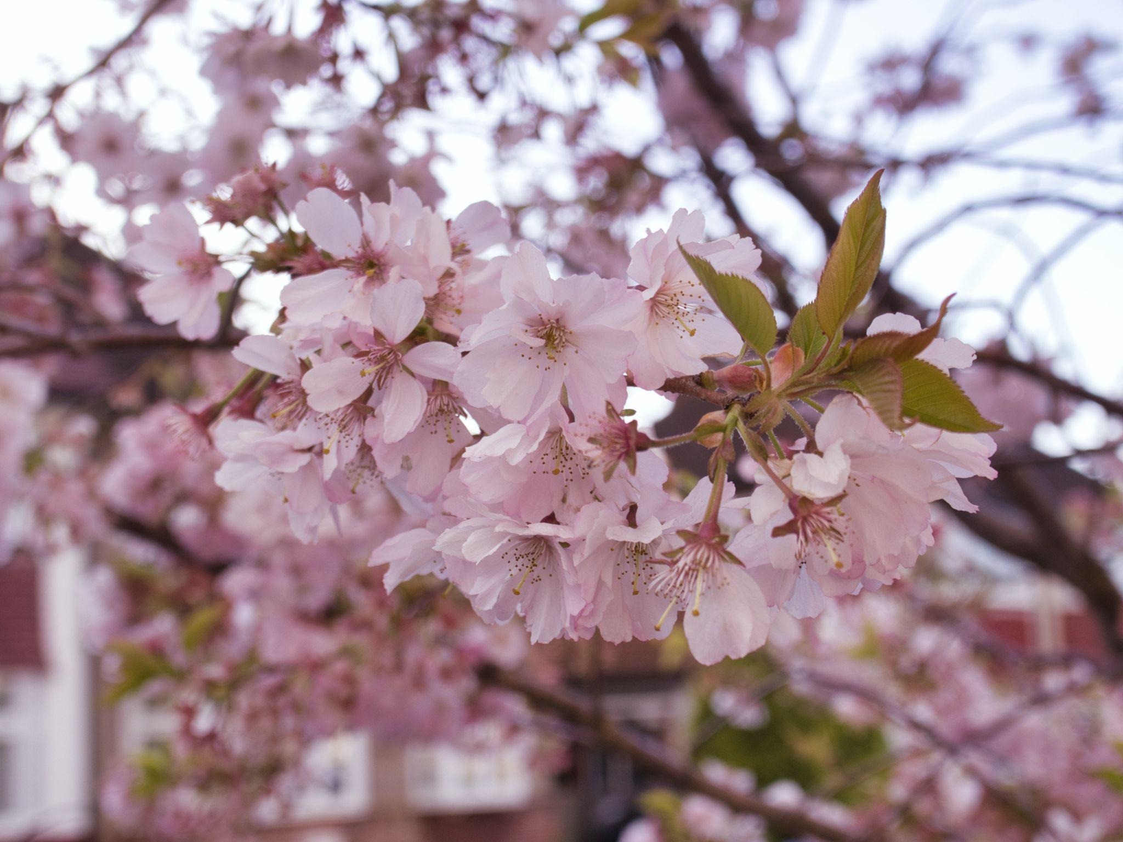
Iris Dataset
Shreyash
Shubham
Ronil
Rutuj
Mohak

Slide 2
Dataset Description
Includes three iris species with 50 samples each as well as some properties about each flower.
One flower species is linearly separable from the other two, but the other two are not linearly separable from each other.

Slide 3
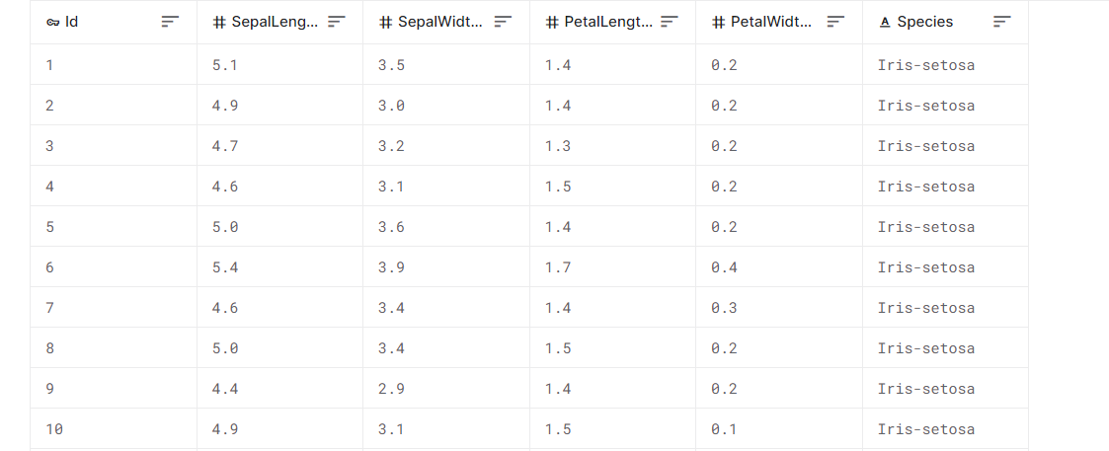
Dataset Info
Columns:
Id
SepalLengthCm
SepalWidthCm
PetalLengthCm
PetalWidthCm
Species

Slide 4
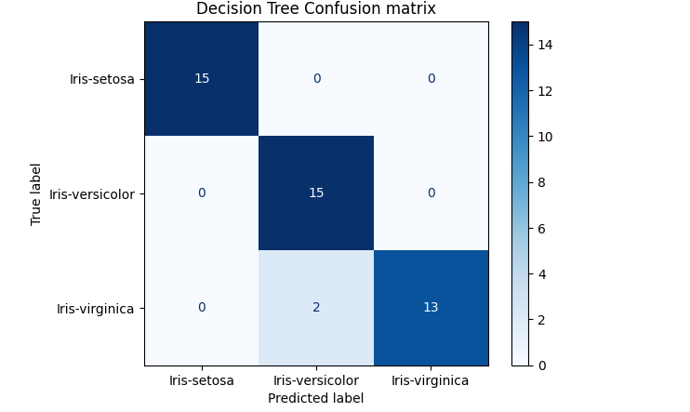
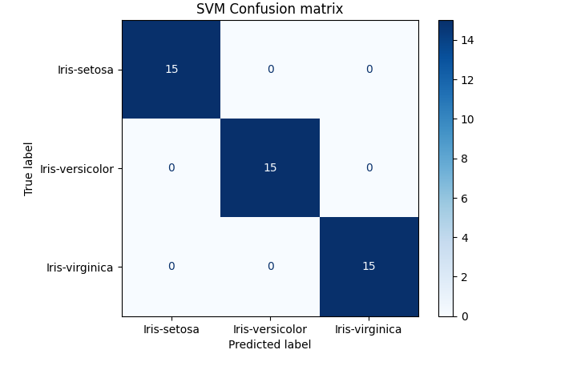

Slide 5
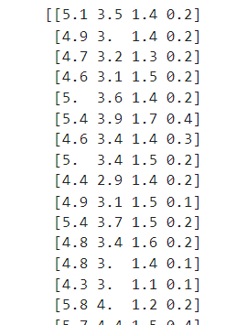
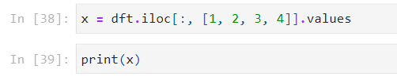
Getting rid of all the class labels

Slide 6
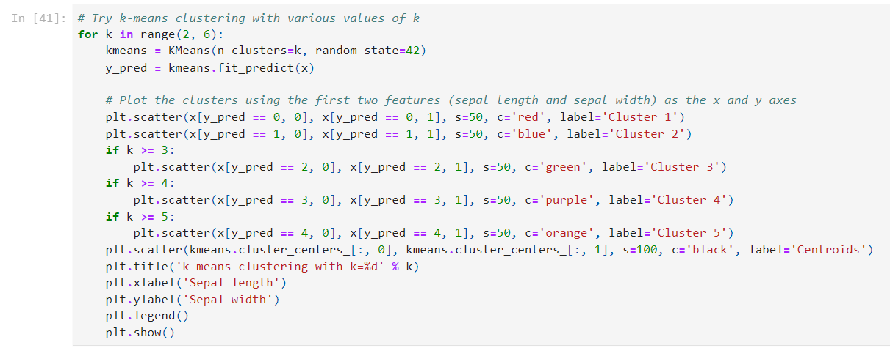
Finding clusters in the data

Slide 7
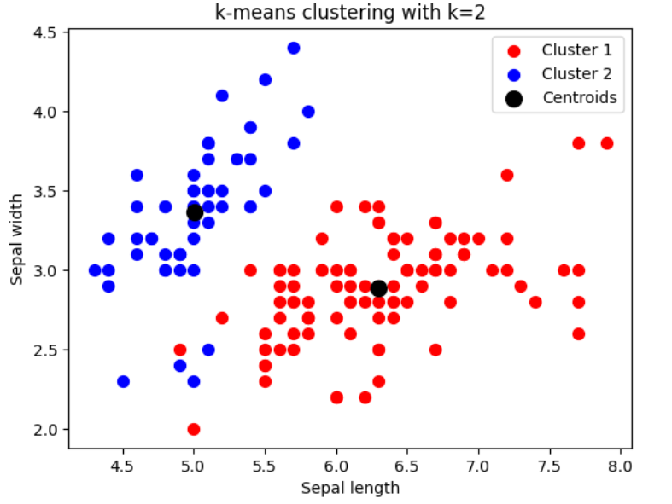
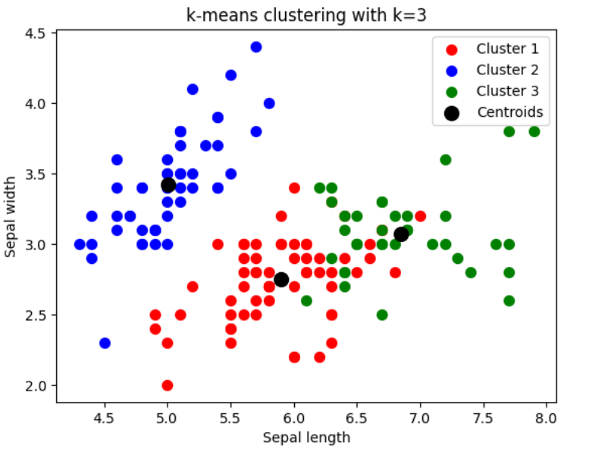
K-means clustering with k=2 & 3

Slide 8
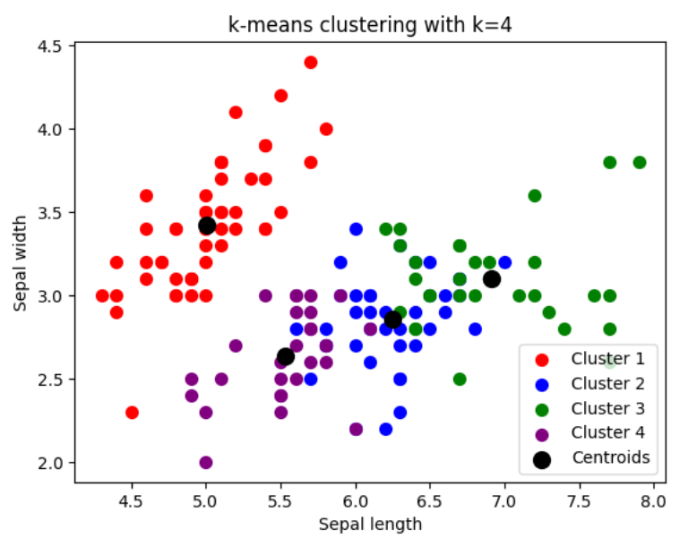
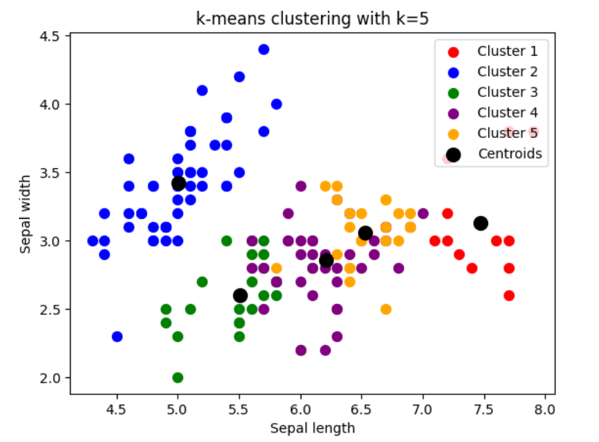
K-means clustering with k=4 & 5

Slide 9
Finding the best k values with supervised and unsupervised methods
supervised and unsupervised learning methods are used to analyze and extract useful information from large datasets.
identify trends and patterns, and develop predictive models.

Slide 10
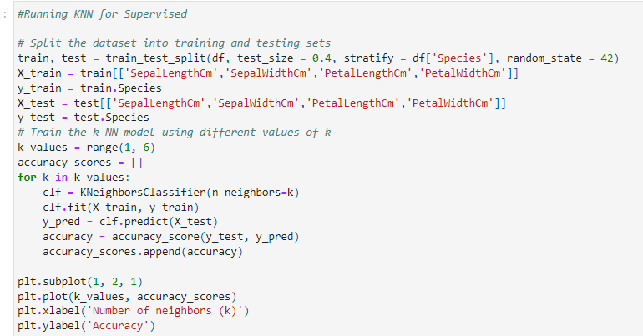
Running KNN for Supervised

Slide 11
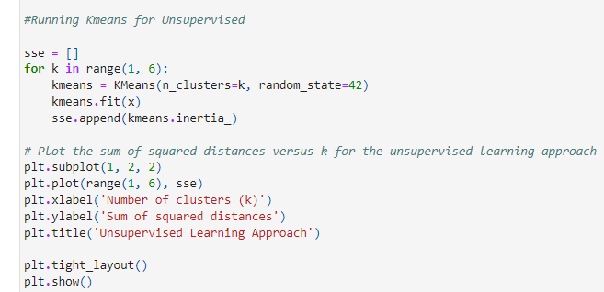
Running K Means for Unsupervised

Slide 12
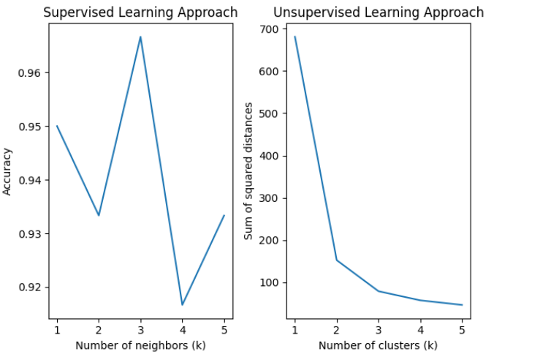
Comparison between the results

Slide 13
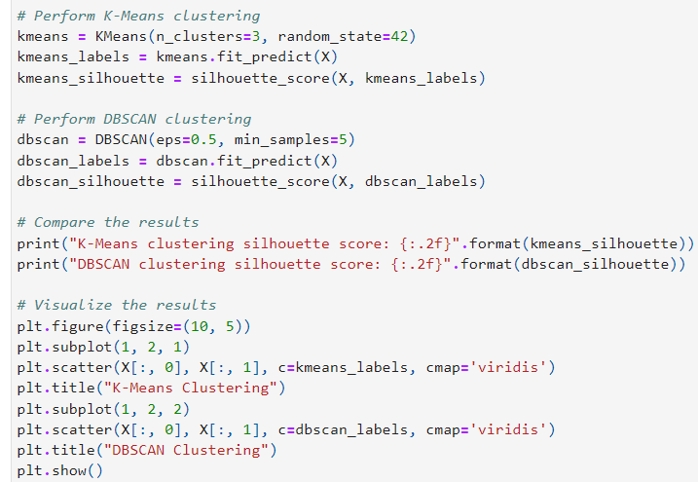
Comparing
K Means and DBSCAN
Clustering

Slide 14
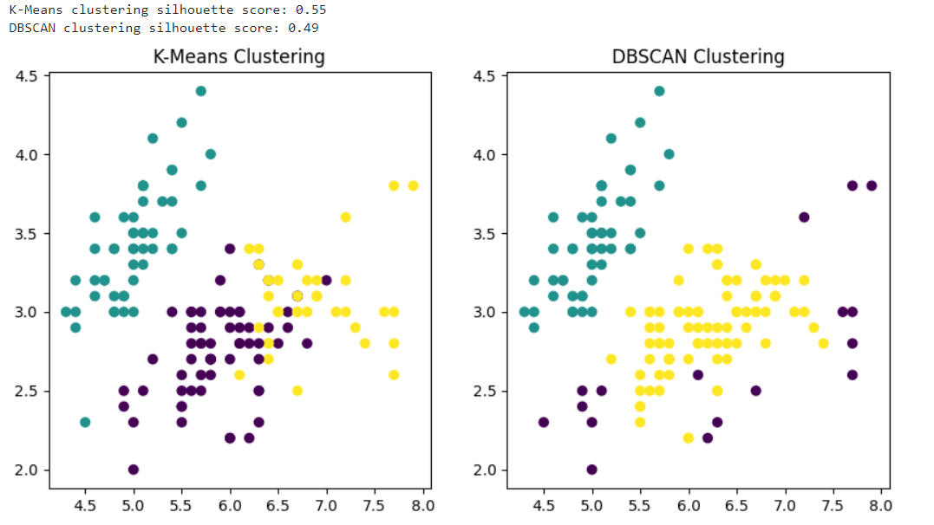

Slide 15
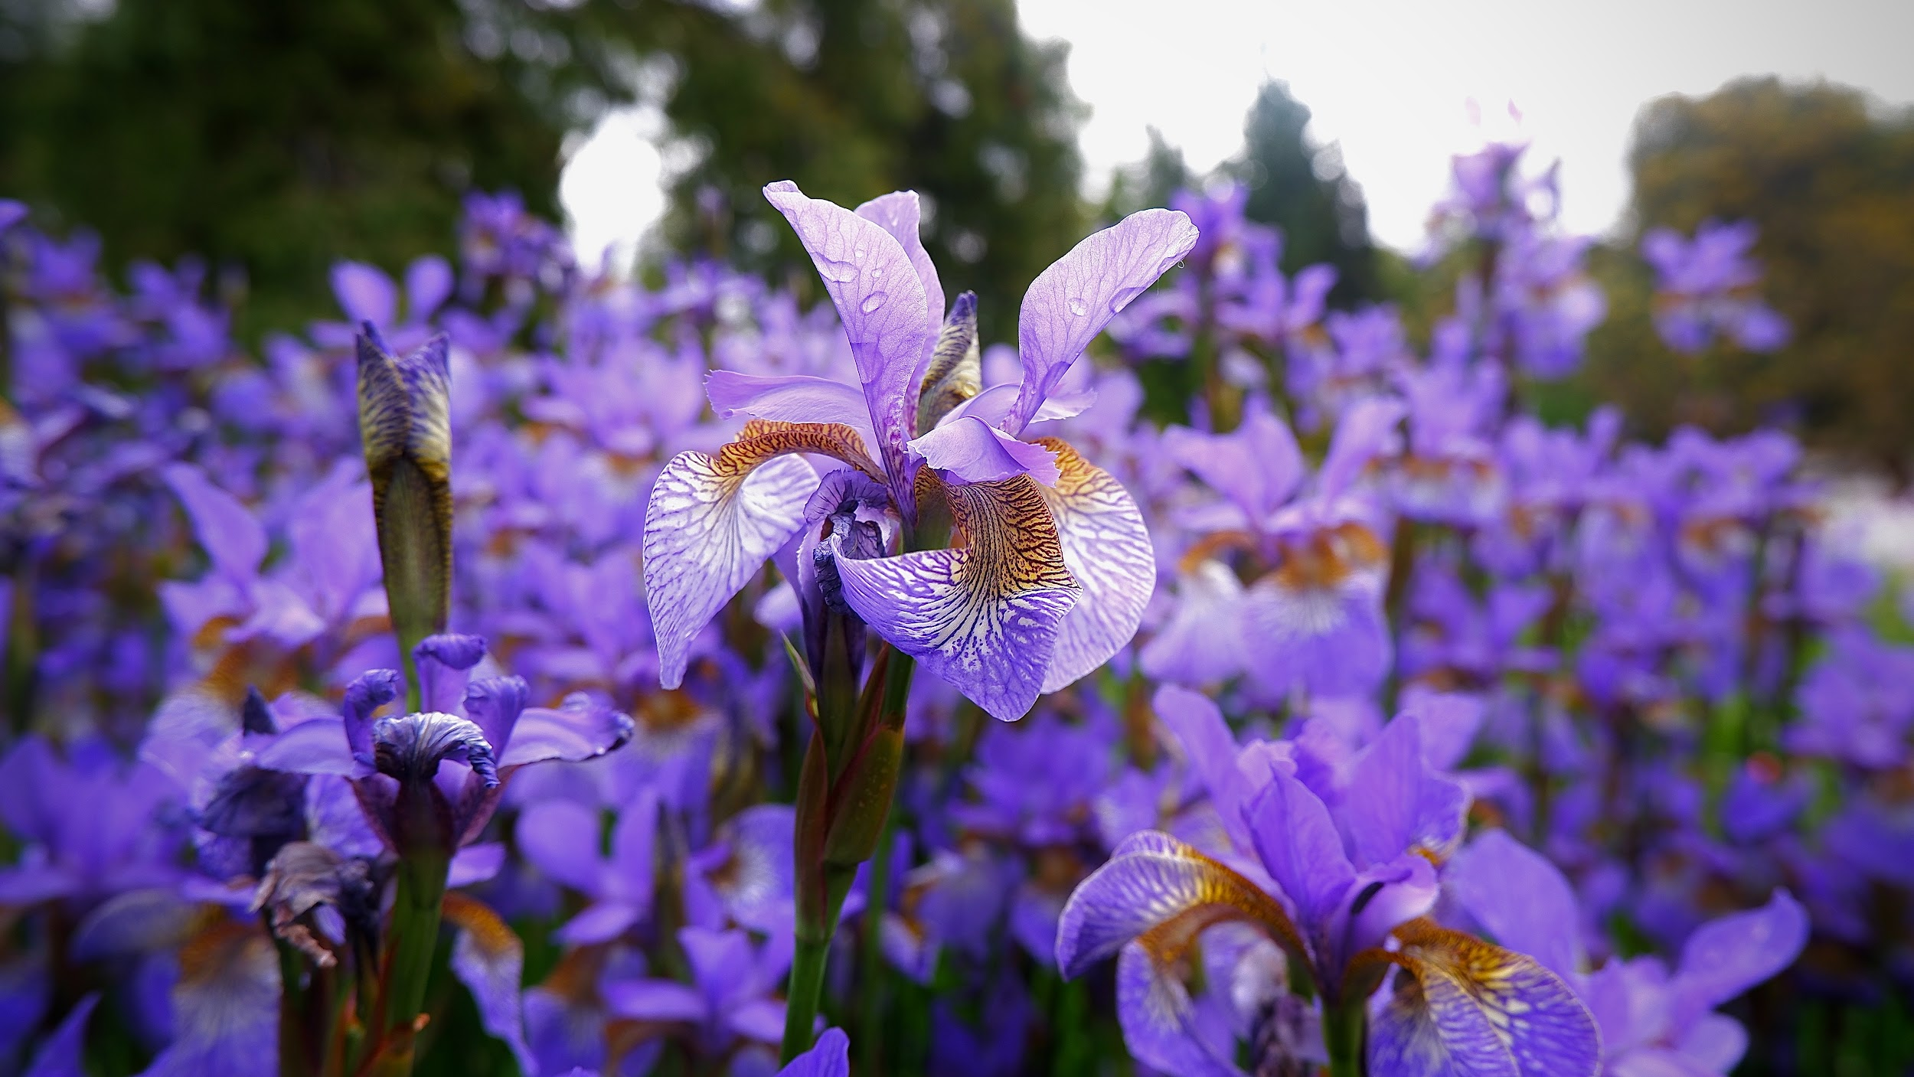
Thank You

